Slide 1
Lecture 10
Backtracking Algorithm
Yaohang Li
Department of Computer Science
ODU
Reading for This Class:
Chapter 6, Russell and Norvig

Slide 2
Review
Last Class
Local Search
Simulated Annealing
Genetic Algorithms
This Class
Constraint Satisfaction Problems
Next Class
Adversarial Search

Slide 3
CSP as a standard search problem
Solution is found at depth n (if there are n variables).
Consider using BFS
Branching factor b at the top level is nd
At next level is (n-1)d
….
end up with n!d^{n} leaves even though there are only d^{n} complete assignments!

Slide 4
Backtracking search
Similar to Depth-first search
Chooses values for one variable at a time and backtracks when a variable has no legal values left to assign.
Uninformed algorithm
No good general performance

Slide 5
Backtracking search
function BACKTRACKING-SEARCH(csp) return a solution or failure
return RECURSIVE-BACKTRACKING({} , csp)
function RECURSIVE-BACKTRACKING(assignment, csp) return a solution or failure
if assignment is complete then return assignment
var ← SELECT-UNASSIGNED-VARIABLE(VARIABLES[csp],assignment,csp)
for each value in ORDER-DOMAIN-VALUES(var, assignment, csp) do
if value is consistent with assignment according to CONSTRAINTS[csp] then
add {var=value} to assignment
result ← RRECURSIVE-BACTRACKING(assignment, csp)
if result ≠ failure then return result
remove {var=value} from assignment
return failure

Slide 6
→ Backtracking Search
empty assignment
1st variable
2nd variable
3rd variable
Assignment = {}

Slide 7
→ Backtracking Search
empty assignment
1st variable
2nd variable
3rd variable
Assignment = {(var1=v11)}

Slide 8
→ Backtracking Search
empty assignment
1st variable
2nd variable
3rd variable
Assignment = {(var1=v11),(var2=v21)}

Slide 9
→ Backtracking Search
empty assignment
1st variable
2nd variable
3rd variable
Assignment = {(var1=v11),(var2=v21),(var3=v31)}

Slide 10
→ Backtracking Search
empty assignment
1st variable
2nd variable
3rd variable
Assignment = {(var1=v11),(var2=v21),(var3=v32)}

Slide 11
→ Backtracking Search
empty assignment
1st variable
2nd variable
3rd variable
Assignment = {(var1=v11),(var2=v22)}

Slide 12
→ Backtracking Search
empty assignment
1st variable
2nd variable
3rd variable
Assignment = {(var1=v11),(var2=v22),(var3=v31)}

Slide 13
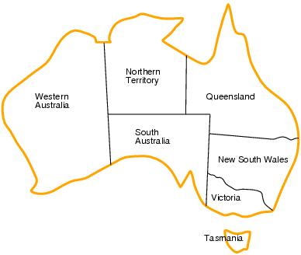
Backtracking example

Slide 14
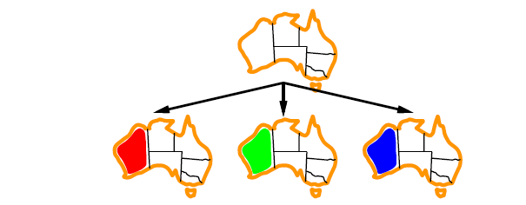
Backtracking example

Slide 15
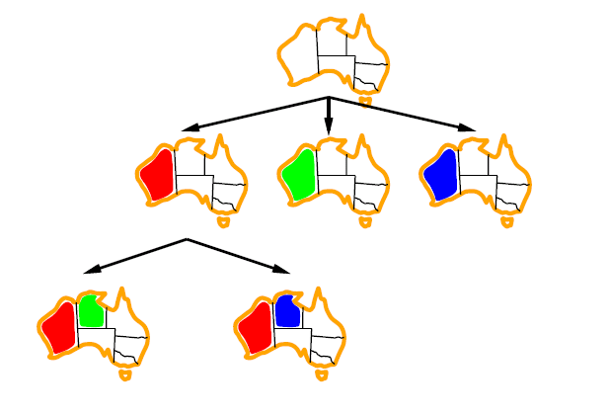
Backtracking example

Slide 16
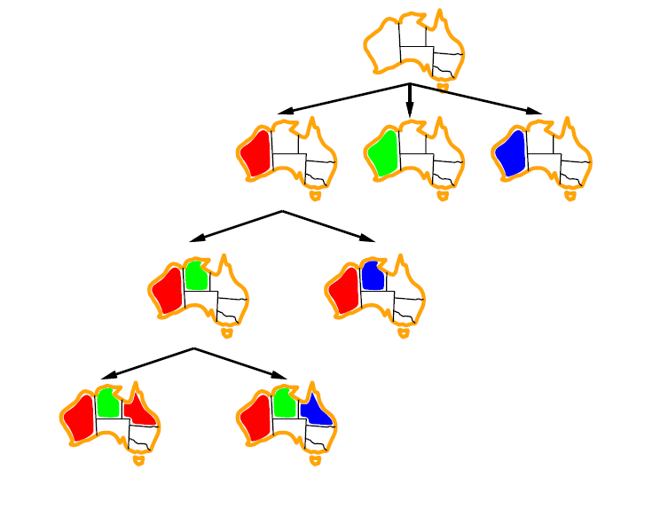
Backtracking example

Slide 17
Improving CSP efficiency
Previous improvements on uninformed search
→ introduce heuristics
For CSPS, general-purpose methods can give large gains in speed, e.g.,
Which variable should be assigned next?
In what order should its values be tried?
Can we detect inevitable failure early?
Can we take advantage of problem structure?
Note: CSPs are somewhat generic in their formulation, and so the heuristics are more general compared to methods in Chapter 4

Slide 18
Backtracking search
function BACKTRACKING-SEARCH(csp) return a solution or failure
return RECURSIVE-BACKTRACKING({} , csp)
function RECURSIVE-BACKTRACKING(assignment, csp) return a solution or failure
if assignment is complete then return assignment
var ← SELECT-UNASSIGNED-VARIABLE(VARIABLES[csp],assignment,csp)
for each value in ORDER-DOMAIN-VALUES(var, assignment, csp) do
if value is consistent with assignment according to CONSTRAINTS[csp] then
add {var=value} to assignment
result ← RRECURSIVE-BACTRACKING(assignment, csp)
if result ≠ failure then return result
remove {var=value} from assignment
return failure

Slide 19

Minimum remaining values (MRV)
var ← SELECT-UNASSIGNED-VARIABLE(VARIABLES[csp],assignment,csp)
A.k.a. most constrained variable heuristic
Heuristic Rule: choose variable with the fewest legal moves
e.g., will immediately detect failure if X has no legal values

Slide 20

Degree heuristic for the initial variable
Heuristic Rule: select variable that is involved in the largest number of constraints on other unassigned variables.
Degree heuristic can be useful as a tie breaker.
In what order should a variable’s values be tried?

Slide 21
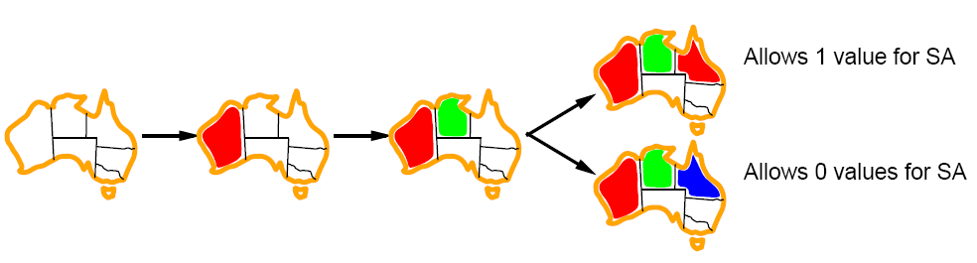
Least constraining value for value-ordering
Least constraining value heuristic
Heuristic Rule: given a variable choose the least constraining value
leaves the maximum flexibility for subsequent variable assignments

Slide 22
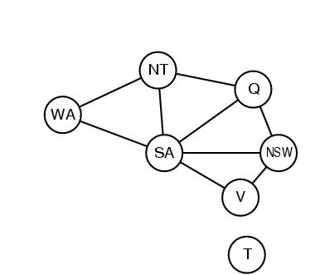
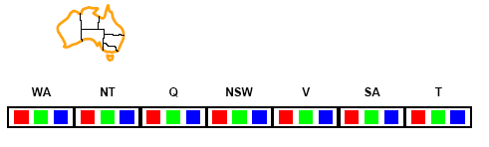
Forward checking
Can we detect inevitable failure early?
And avoid it later?
Forward checking idea: keep track of remaining legal values for unassigned variables.
Terminate search when any variable has no legal values.

Slide 23
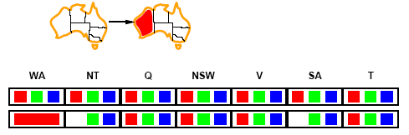
Forward checking
Assign {WA=red}
Effects on other variables connected by constraints to WA
NT can no longer be red
SA can no longer be red

Slide 24
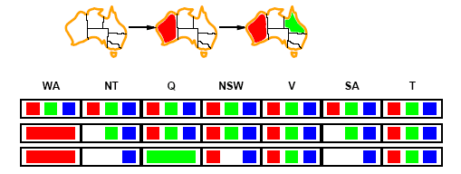
Forward checking
Assign {Q=green}
Effects on other variables connected by constraints with WA
NT can no longer be green
NSW can no longer be green
SA can no longer be green
MRV heuristic would automatically select NT or SA next

Slide 25
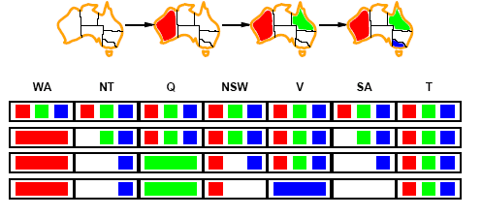
Forward checking
If V is assigned blue
Effects on other variables connected by constraints with WA
NSW can no longer be blue
SA is empty
FC has detected that partial assignment is inconsistent with the constraints and backtracking can occur.

Slide 26
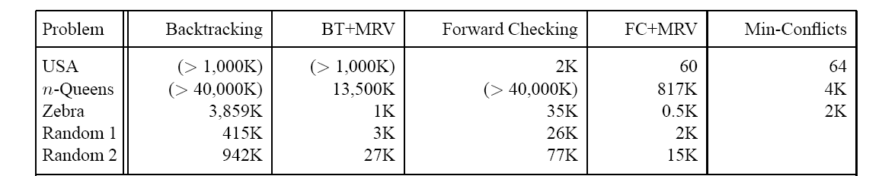
Comparison of CSP algorithms on different problems
Median number of consistency checks over 5 runs to solve problem
Parentheses -> no solution found
USA: 4 coloring
n-queens: n = 2 to 50
Zebra: see exercise 5.13

Slide 27
Summary
Backtracking Algorithm
Minimum remaining values
Degree heuristics
Least constraining values
Forward checking

Slide 28
What I want you to do
Review Chapter 6
Work on your assignment
Organize your project team

